Slide 1
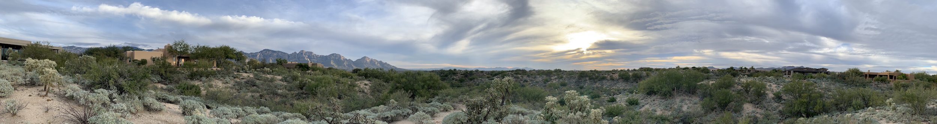


Machine Assisted Extraction, Curation, Transformation and Augmentation
Clayton T. Morrison
ml4ai.github.io/automates
ASKE PI Meeting
15 May 2019

Slide 2
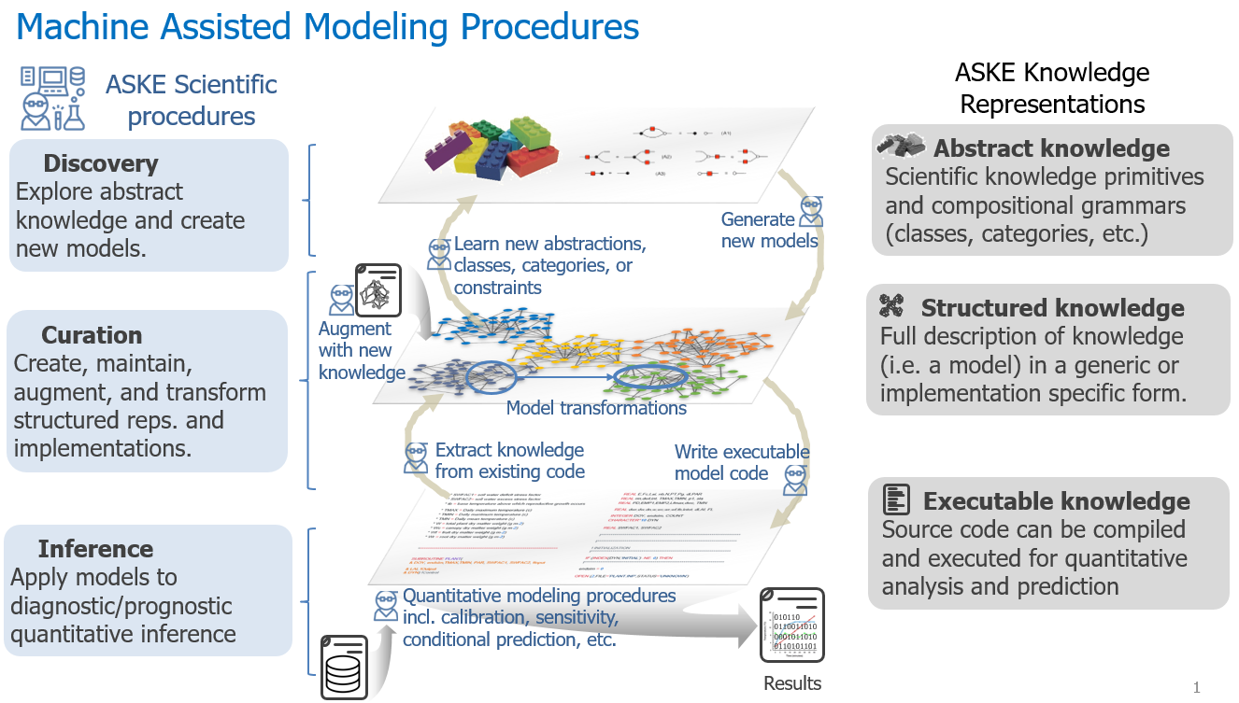
Machine Assisted Extraction, Curation, Transformation and Augmentation Framing the Concept

Slide 3
Machine Assisted Extraction, Curation, Transformation and Augmentation Framing the Concept
Extraction
Software, Text, Equations, Figures, Tables, other semi-structured data
Constraints: parameter types, value constraints
Curation
Uniform(*) representation enabling queries, operations, compilation
Grounding / Linking variables to taxonomies/ontologies
HMI, model/data store
Transformation
Model comparison / difference
Component extraction
Augmentation
Analysis: variable domain inference, sensitivity
Composition
Experiment design

Slide 4
Machine Assisted Extraction, Curation, Transformation and Augmentation Progress
The view from …
University of Arizona: AutoMATES
https://ml4ai.github.io/automates/
Siemens
https://github.com/deepcurator/DCC
Harvard Medical School
https://github.com/indralab/emmaa
https://emmaa.readthedocs.io
University of Wisconsin
https://github.com/UW-COSMOS/project-docs/tree/master/presentations_reports/milestone_3

Slide 5
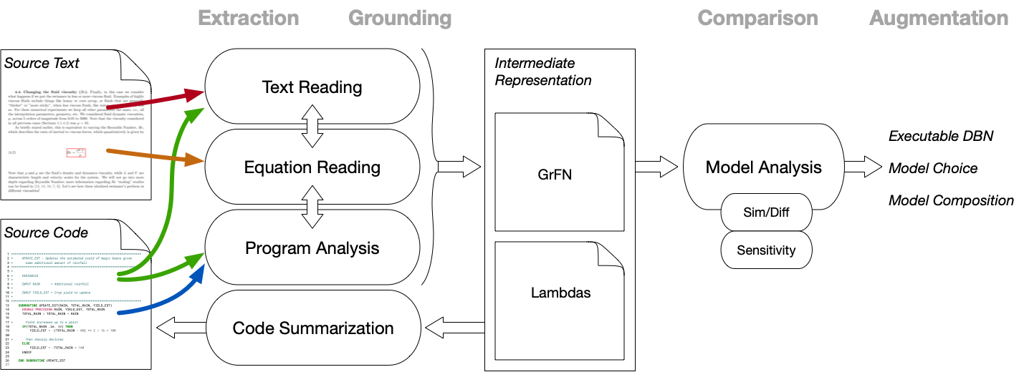
AutoMATES Architecture
ml4ai.github.io/automates

Slide 6
From source...
crop_yield.f
28 ************************************************************************ 29 * CROP_YIELD - Estimate the yield of magic beans given a simple 30 * model for rainfall 31 ************************************************************************ 32 * 33 * VARIABLES 34 * 35 * INPUT MAX_RAIN = The maximum rain for the month 36 * INPUT CONSISTENCY = The consistency of the rainfall 37 * (higher = more consistent) 38 * INPUT ABSORBTION = Estimates the % of rainfall absorbed into the 39 * soil (i.e. % lost due to evaporation, runoff) 40 * 41 * OUTPUT YIELD_EST = The estimated yield of magic beans 42 * 43 * DAY = The current day of the month 44 * RAIN = The rainfall estimate for the current day 45 * 46 ************************************************************************ 47 PROGRAM CROP_YIELD 48 IMPLICIT NONE 49 50 INTEGER DAY 51 DOUBLE PRECISION RAIN, YIELD_EST, TOTAL_RAIN 52 DOUBLE PRECISION MAX_RAIN, CONSISTENCY, ABSORBTION 53 54 MAX_RAIN = 4.0 55 CONSISTENCY = 64.0 56 ABSORBTION = 0.6 57 58 YIELD_EST = 0 59 TOTAL_RAIN = 0 60 61 DO 20 DAY=1,31 62 * Compute rainfall for the current day 63 RAIN = (-(DAY - 16) ** 2 / CONSISTENCY + MAX_RAIN) * ABSORBTION 64 65 * Update rainfall estimate 66 CALL UPDATE_EST(RAIN, TOTAL_RAIN, YIELD_EST) 67 PRINT *, "Day ", DAY, " Estimate: ", YIELD_EST 68 69 20 ENDDO 70 71 PRINT *, "Crop Yield(%): ", YIELD_EST 72 73 END PROGRAM CROP_YIELD
1 ************************************************************************ 2 * UPDATE_EST - Updates the estimated yield of magic beans given 3 * some additional amount of rainfall 4 ************************************************************************ 5 * 6 * VARIABLES 7 * 8 * INPUT RAIN = Additional rainfall 9 * 10 * INOUT YIELD_EST = Crop yield to update 11 * 12 ************************************************************************ 13 SUBROUTINE UPDATE_EST(RAIN, TOTAL_RAIN, YIELD_EST) 14 DOUBLE PRECISION RAIN, YIELD_EST, TOTAL_RAIN 15 TOTAL_RAIN = TOTAL_RAIN + RAIN 16 17 * Yield increases up to a point 18 IF(TOTAL_RAIN .le. 40) THEN 19 YIELD_EST = -(TOTAL_RAIN - 40) ** 2 / 16 + 100 20 21 * Then sharply declines 22 ELSE 23 YIELD_EST = -TOTAL_RAIN + 140 24 ENDIF 25 26 END SUBROUTINE UPDATE_EST
27
function
(program, subroutine)
var declarations
conditional
var assignments
loop

Slide 7
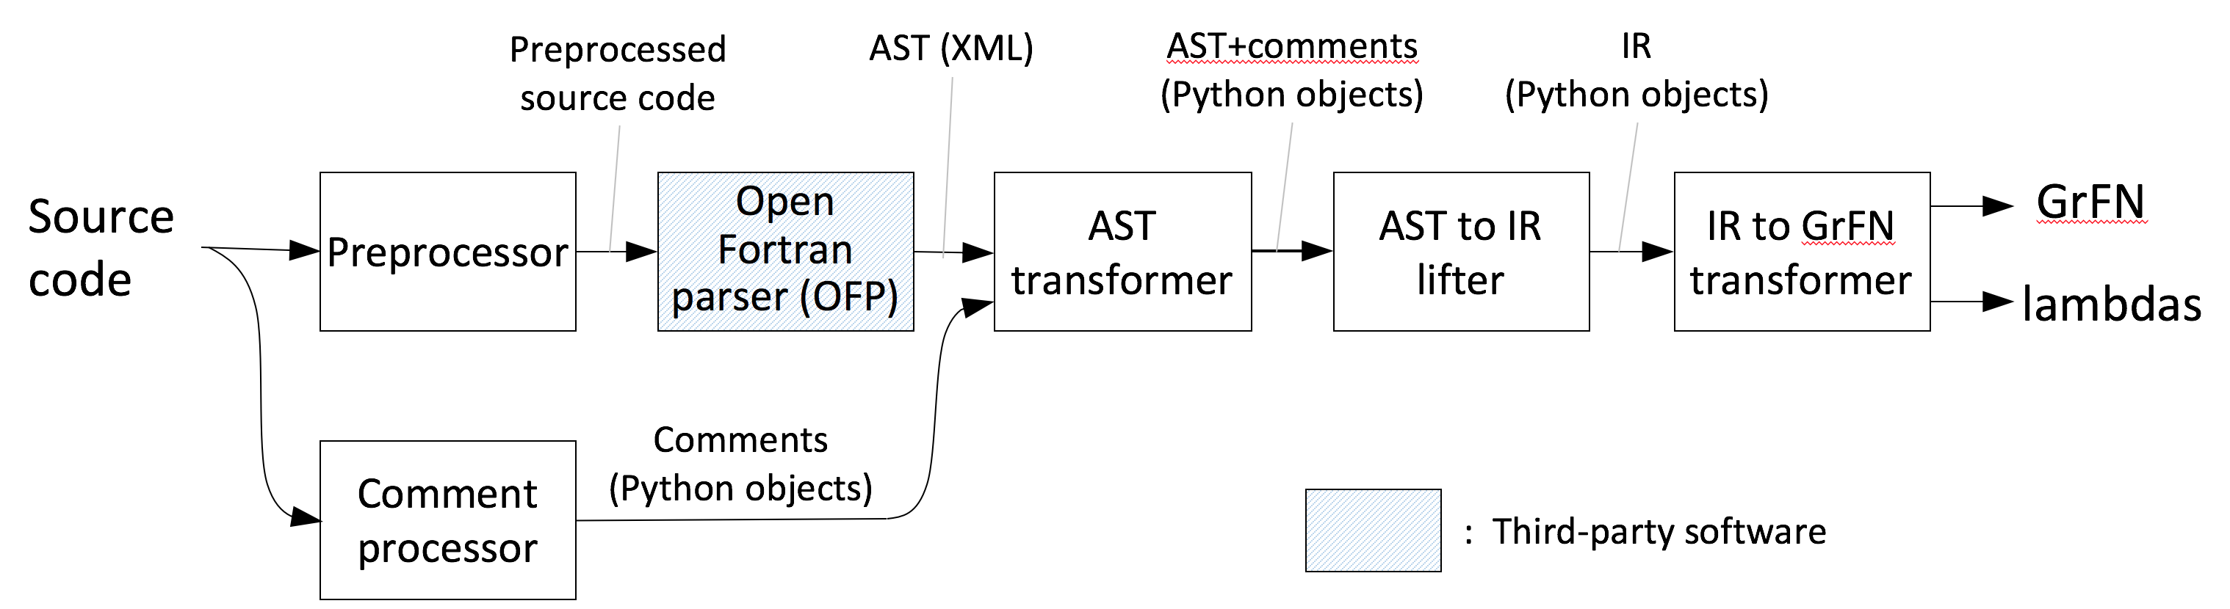
Program Analysis

Slide 8
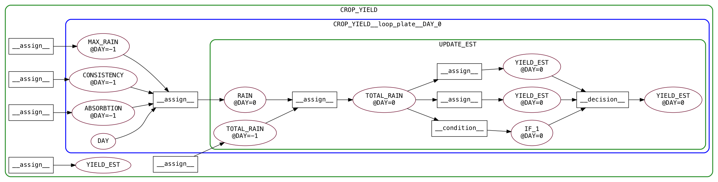
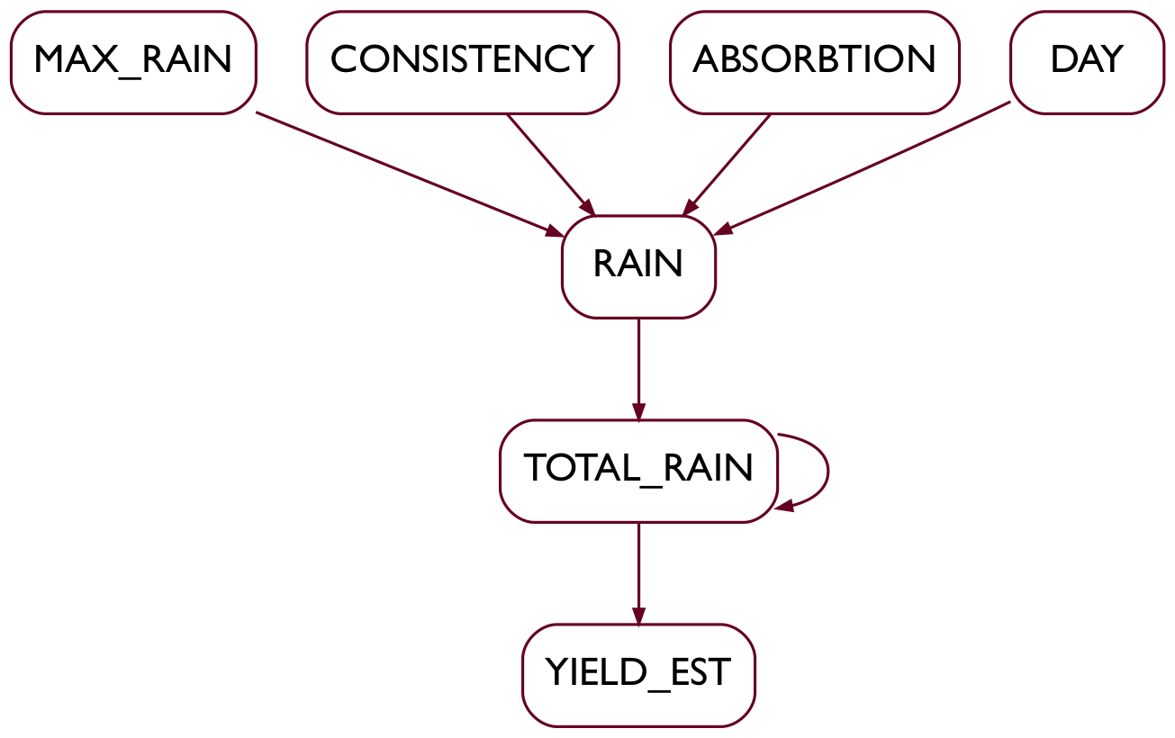
... derive:
GrFN: Grounded Function Network
Executable DBN
… with associated comments

Slide 9
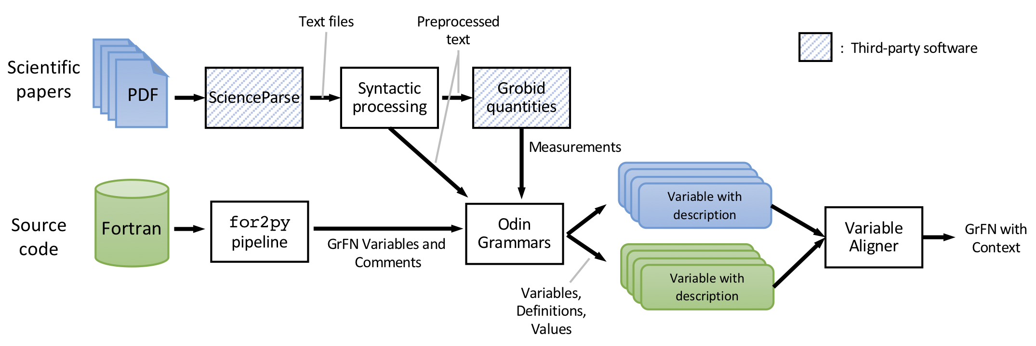
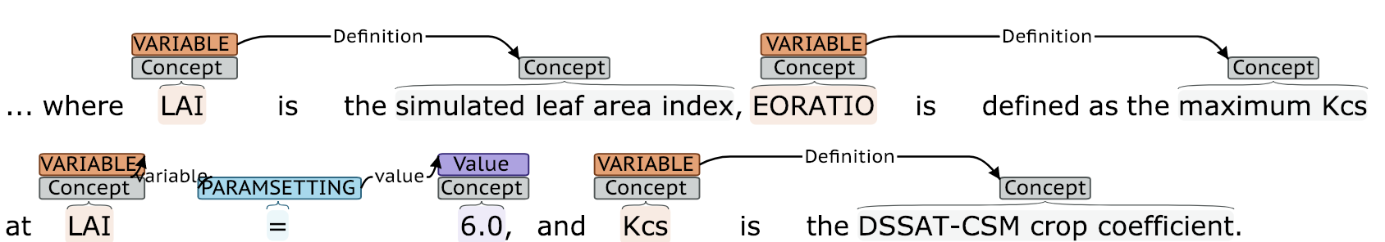
Text Reading
ml4ai.github.io/automates
Notes:
Developing Odin grammar for extracting definitions of variables linked to scientific concepts

Slide 10
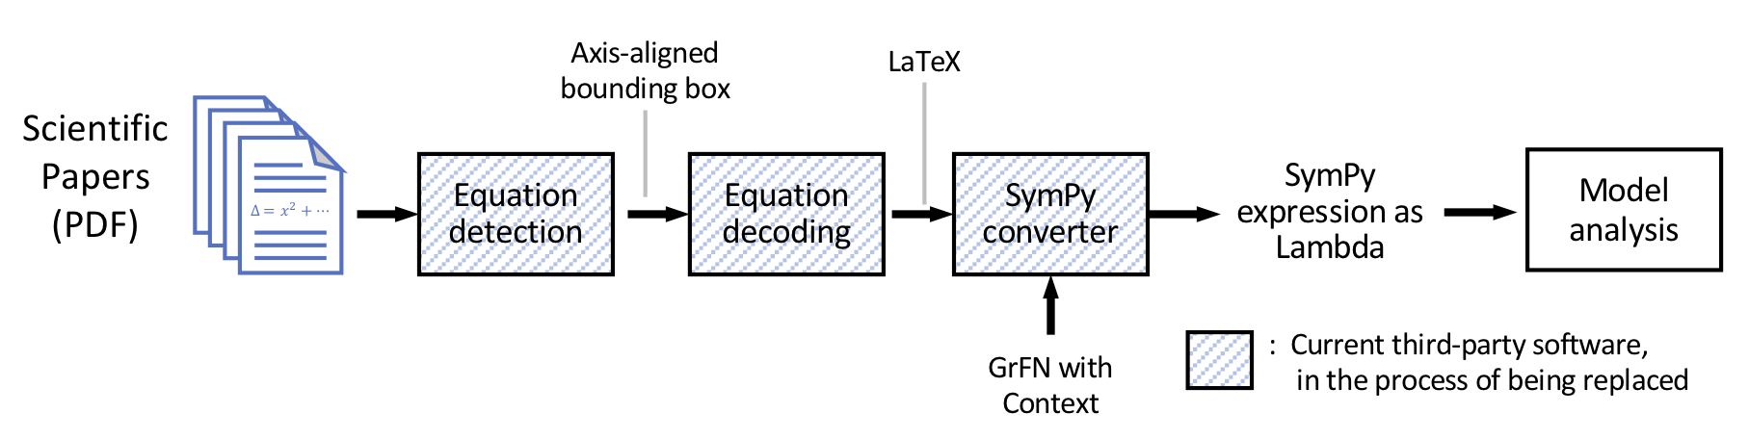
Equation Reading
ml4ai.github.io/automates
Notes:
Note that to interpret Re as a single variable, need textual context

Slide 11
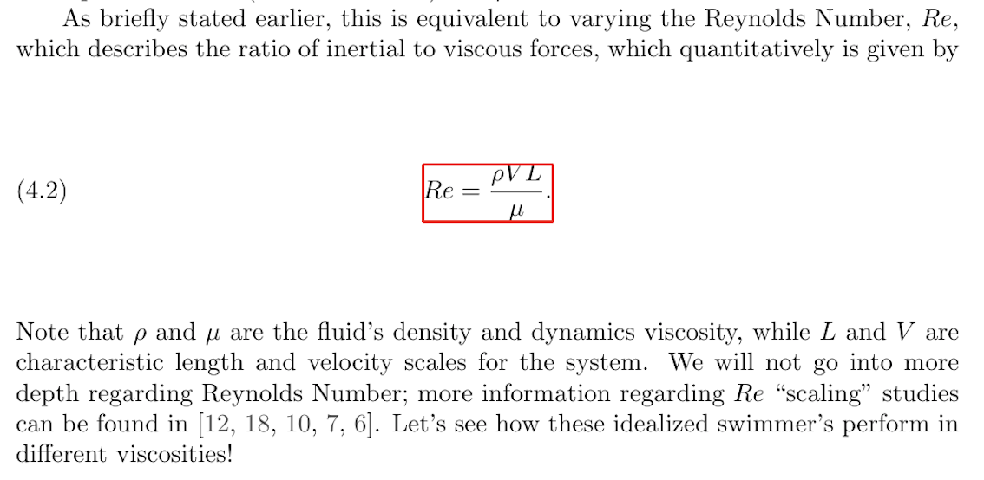
Equation Reading in Context
ml4ai.github.io/automates
Re = \frac{\rho V L}{\mu}
def Re(rho, V, L, mu):
return (rho * V * L) / mu
Notes:
Note that to interpret Re as a single variable, need textual context

Slide 12
GrFN: Grounded Function Network
ml4ai.github.io/automates
Lambdas
def assign_RAIN(MAX_RAIN, CONSISITENCY, ABSORPTON, DAY)
return (-(DAY - 16) ** 2 / CONSISTENCY + MAX_RAIN)
* ABSORBTION
Variable Metadata
Comments
Links to scientific concepts
Variable Domains: Types, ranges, default values

Slide 13
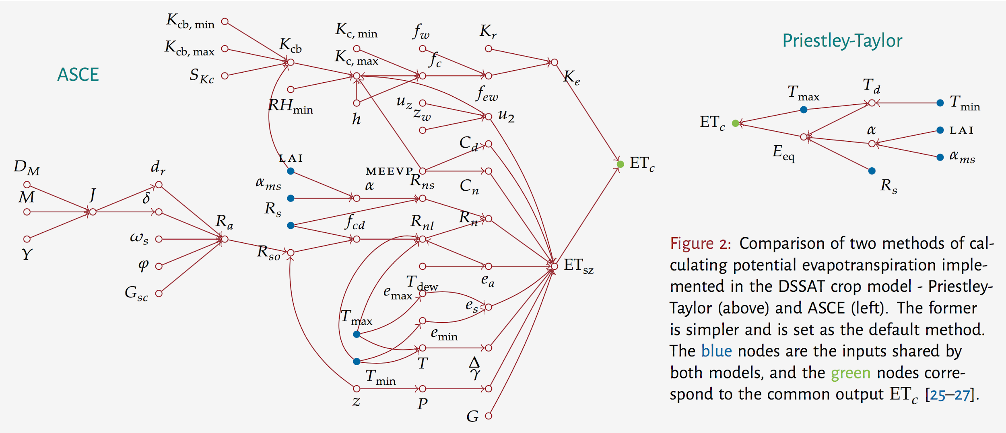
Model Analysis: Structural Comparison
Notes:
Two models of evapotranspiration from the DSSAT model
- two methods of calculating the same quantity, potential evapotranspiration
- obviously, one is much more computationally complex than the other
- when is it worth the extra computational cost?
- which model is more robust/sensitive to input parameters? for what values of the parameters? can we systematically answer this question?
- the networks shown on the slide are hand-constructed by reading the source code, equations, and text, and normalizing variable names by hand - we would ideally like to automate this process.

Slide 14
ml4ai.github.io/automates
Model Analysis: Structural Comparison

Slide 15
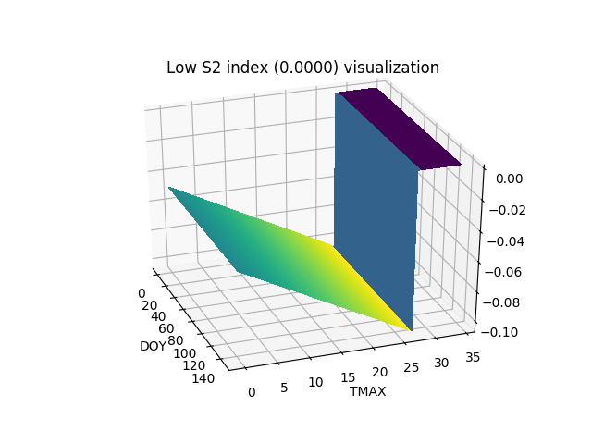
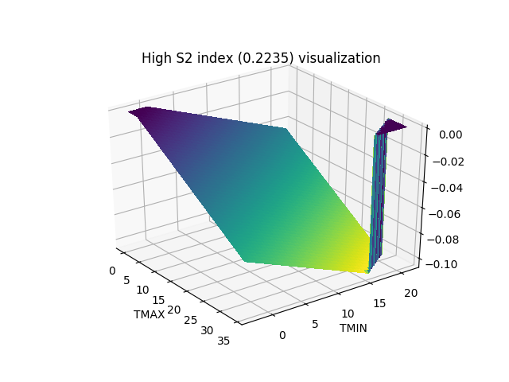
ml4ai.github.io/automates
Model Analysis: Sobol Sensitivity Analysis
dLAI
dLAI
DOY
TMAX
TMIN
TMAX
Sensitivity index computation using Sobol sensitivity analysis
Computing the sensitivity indices allows us to see which variables and which pairs of variables account for the most variance in overall model output
Notes:
In the images shown above we see two 3D surfaces. Each of these are constructed from our PLANT.for Fortran program. The z-axis for both of these plots is the model output, dLAI (change in Leaf Area Index) from the PLANT program. The xy coordinates of the two plots represent the input variable pairs with lowest and highest sensitivity respectively. Here highest sensitivity means the pair of inputs that induce the greatest amount of variability in the output. The graphics are here to help us visualize the difference. As you can see from the graphic on the left, dLAI remains unchanged with respect to DOY, whereas both TMIN and TMAX affect the variability of dLAI, and they do so jointly, as evident by the flattening of the surface on the right in two locations.
DOY = day of the year
TMAX = Daily maximum temperature (c)
TMIN = Daily maximum temperature (c)
dLAI = daily increase in leaf area index (m2/m2/d)

Slide 16
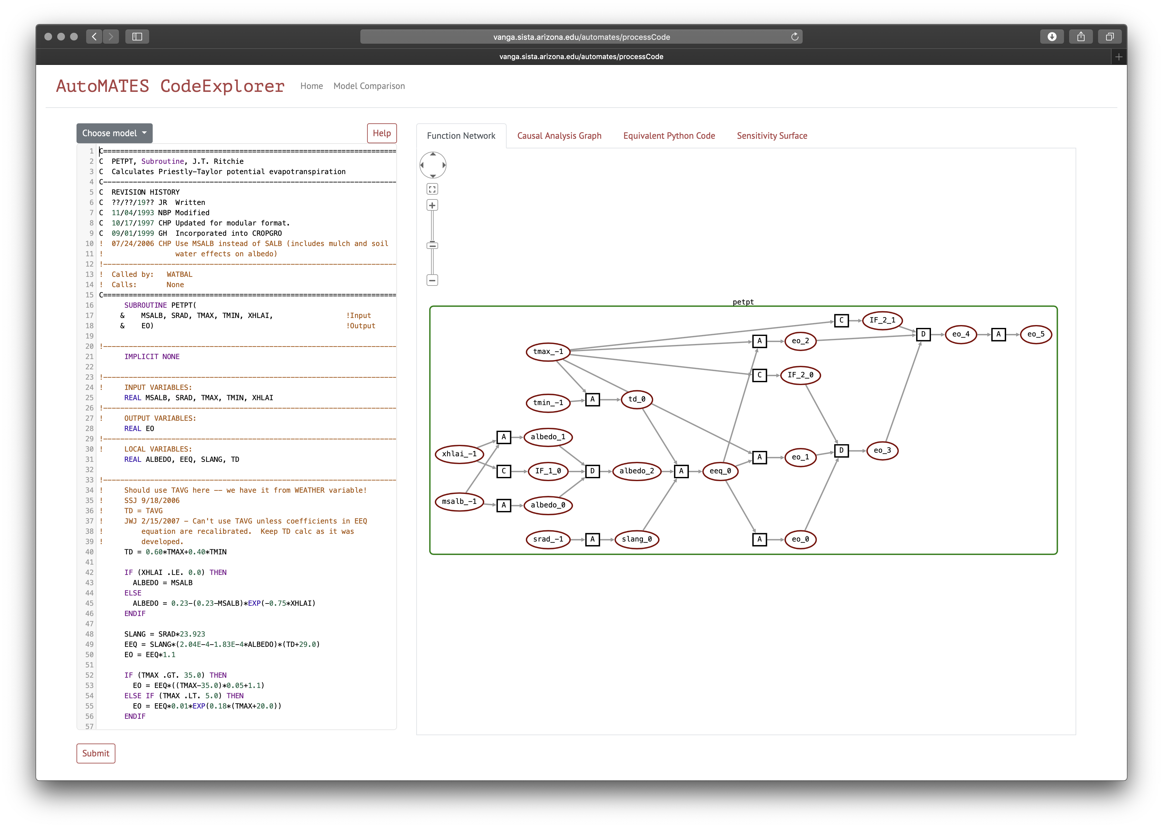
CodeX: http://vanga.sista.arizona.edu/automates

Slide 17
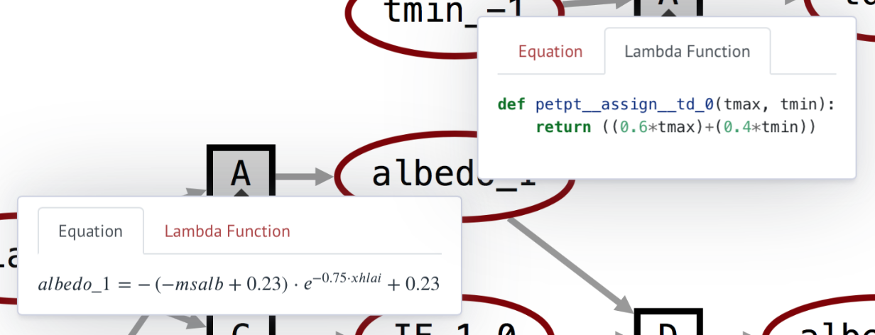
CodeX: http://vanga.sista.arizona.edu/automates

Slide 18
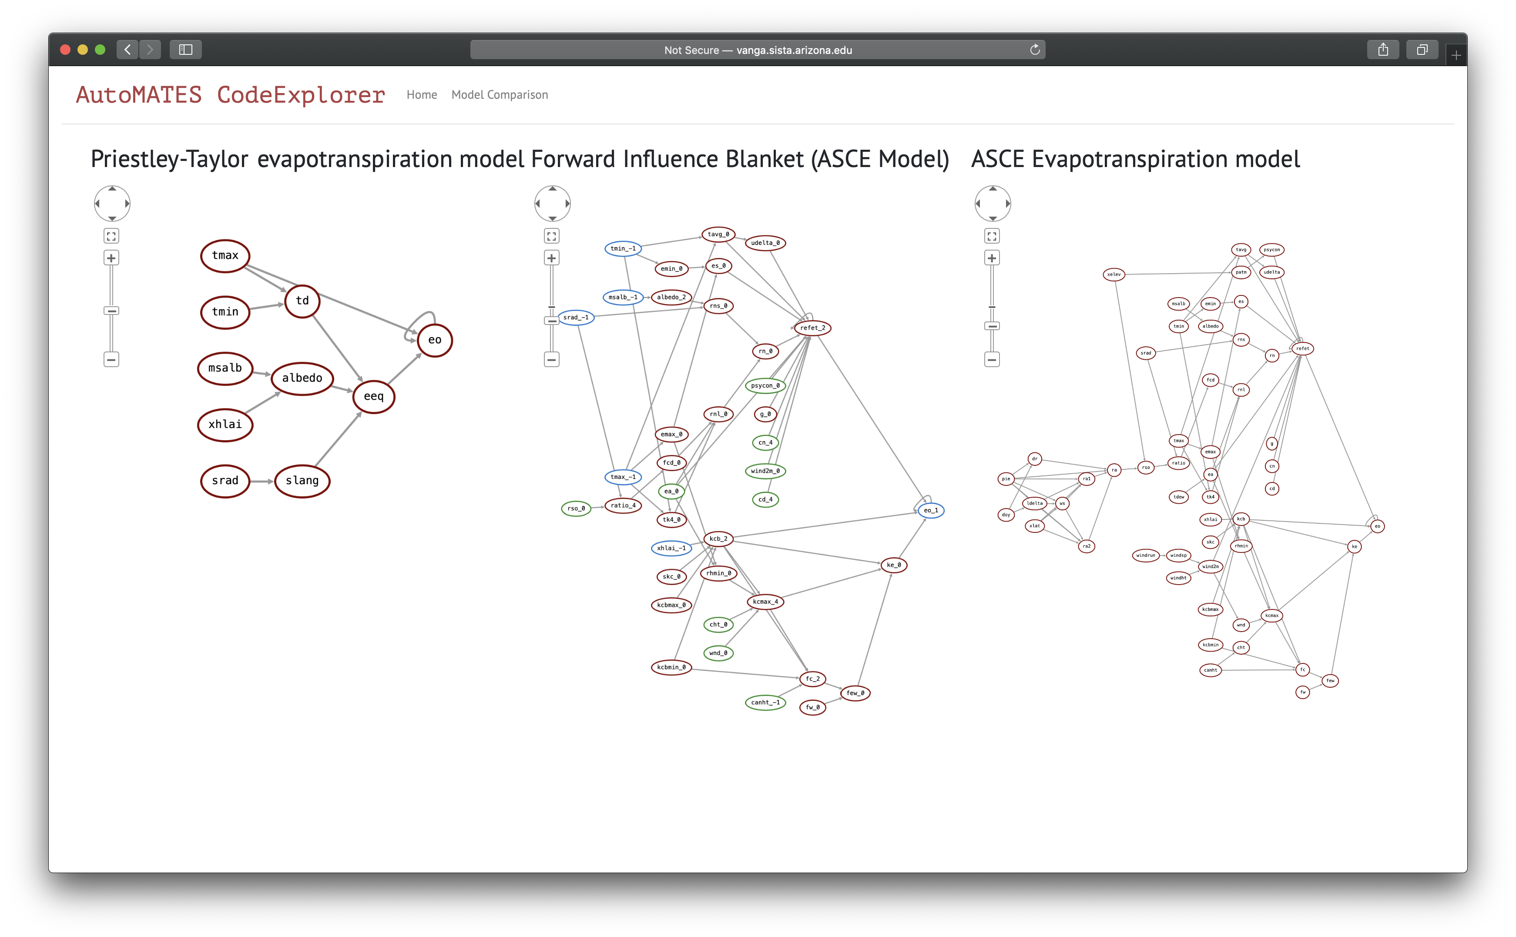
CodeX: http://vanga.sista.arizona.edu/automates

Slide 19
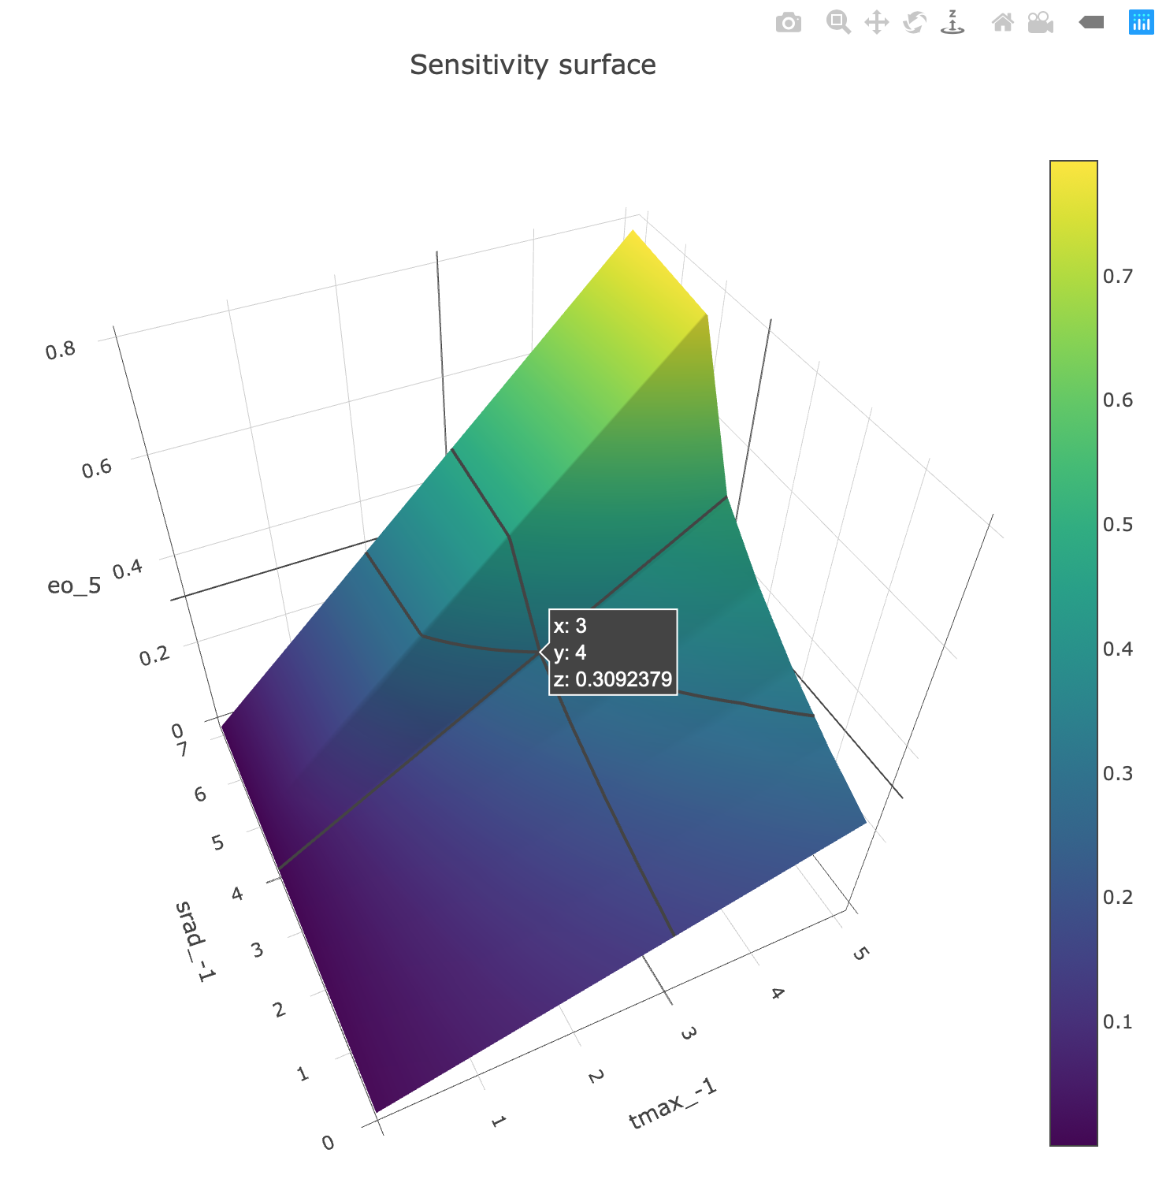
CodeX: http://vanga.sista.arizona.edu/automates

Slide 20
ml4ai.github.io/automates
Summary AutoMATES Phase 1
Integration of model semantics
from text, equations and software
into a uniform framework for analysis.
Code Explorer
Fortran Program Analysis and GrFN
Modules / Namespaces
Derived Types
Comment handling
Text Reading
Integration of grobid-quantities (normalizing units)
Expansion of extraction grammar: Identifying concepts and definitions, variable assignment/constraints
Concept/variable alignment
Equation Reading
Equation detection: Mask-RCNN
Equation to code: Encode/decoder im2markup variant for image to latex, Latex to SymPy
Model Analysis
Model comparison / differencing
Sensitivity analysis

Slide 21
Machine Assisted Extraction, Curation, Transformation and Augmentation Challenges, Gaps

